Slide 1
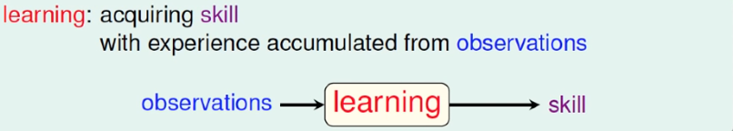
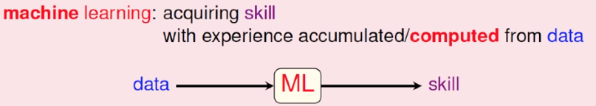
What is Machine Learning
What is learning? Human learn skills by digesting observations with brain
What skills? Do things valuable
(e.g. recognition/classification/prediction)
What is learning? Machine learn skills by analyzing data with CPU

Slide 2
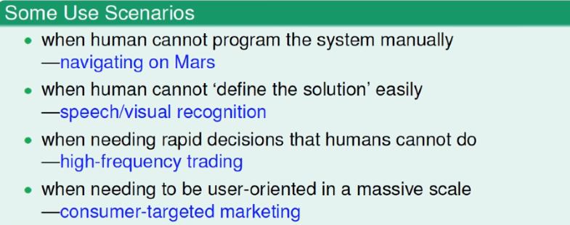
Why and when for Machine Learning
training/test
-Why
Traditional programing:
Define problem
Program with logic and rules and machine execution
Limitations => can not handle complicated system
e.g. Recognize if there’s a tree in a photograph ?
=> hard to define a tree with rules (traditional programing limitations)
ML solution : with lots of data (with tree or not) for computer to learn
-When
data
(observation)
validate
feed
pattern
(model)
algorithm
machine
(computer)
-Application => datamining everywhere
Finance
Law
Medical
Entertainment
Customer labeling
User habit insights

Slide 3
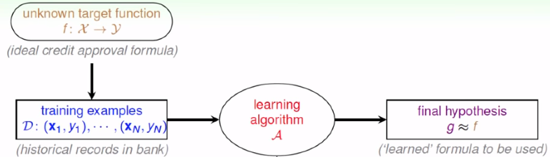
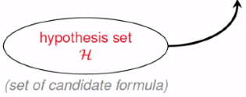
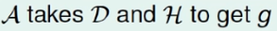
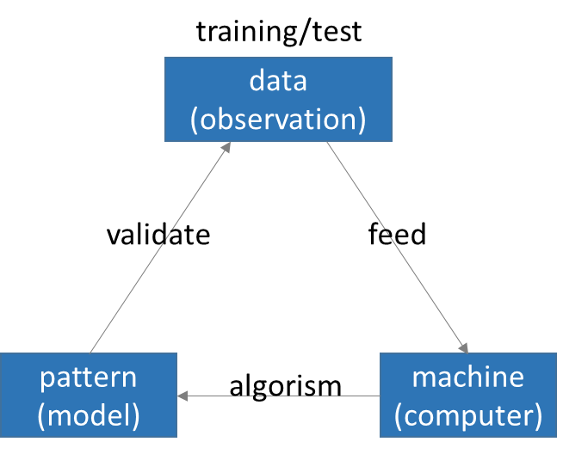
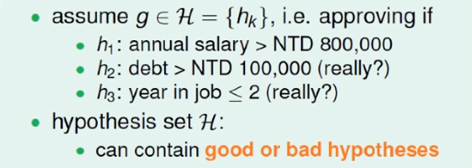
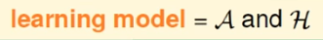
Machine Learning flow procedure
Input X 與 Output Y 有未知的f關係
g = 推測的結果希望很接近f
g : X → Y (f : X → Y)
推測可能的公式(pattern)
通常有一群(h1/h2/h3)
Hypothesis set in algorism
will decide the final suitable hypothesis

Slide 4
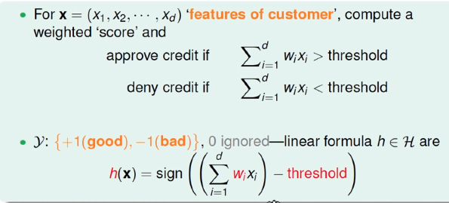
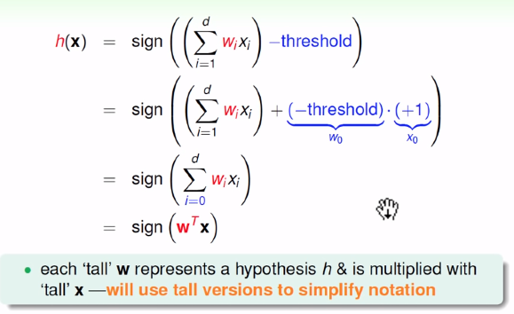
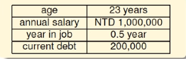
Perceptron : a simple hypothesis (learning to answer Yes or No)
An ancient and traditional explanation for classification
Question : issue to customer credit card or not ?
Data : Customer data with various attributes (age/salary/debt..)
hypothesis : Preceptron
一筆顧客資料具有多個欄位屬性, 乘以各屬性的權重(weight), 得到 score
若 score > 門檻(threshold) 則為 Yes (+1), 反之 No (-1)
把threshold當做第零個維度, hypothesis 即是attribute向量與權重向量的內積值

Slide 5
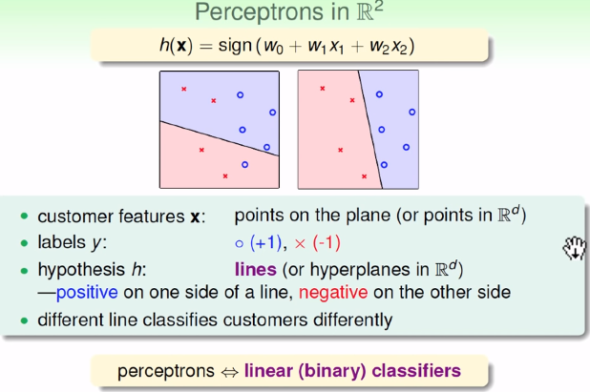
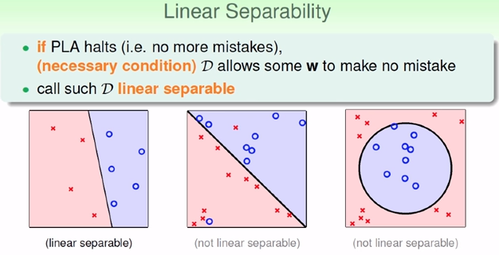
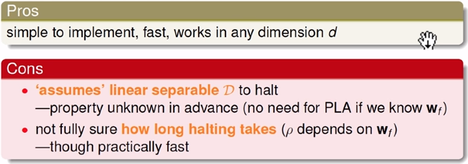
Perceptron : a linear classifier
An easy 2-Dimensional plot (實際情況是多維度)
h(x) 是一條線, 分隔出+1與-1 (w0 + w1X1 + w2x2 是一條線)
Perceptron is for linear separable condition. (實際情況無法確認是否為linear separable)

Slide 6
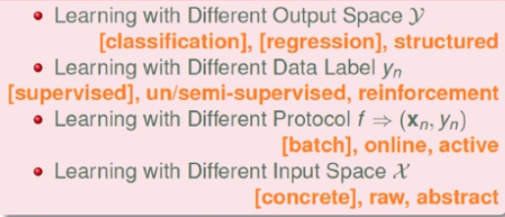
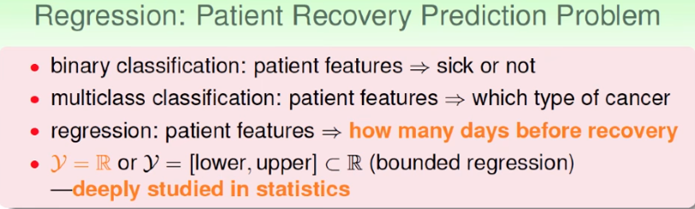
Learning with different output space Y
Previously, Yes/No answer with Perceptron Learning Algorithm
Binary classification is the simplest one
More complicated =>
Multiclass classification (影像辨識/聲音辨識)
Regression prediction
Structured Learning (文字語句分析: 1. 剖析語句 2. 分出名詞/動詞)
Learning with different input space X
Domain knowledge (你怎麼知道要挑選什麼參數拿來訓練)
Coin recognition => size/mass
Credit card issue => salary/debt/age
Feature Engineering => 特徵工程 : 決定要餵給機器什麼數據
Abstract feature is more difficult (音樂類型/喜好分類…)

Slide 7
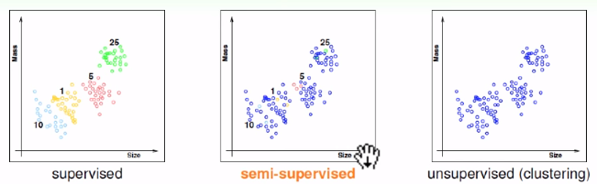
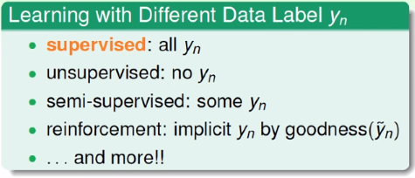
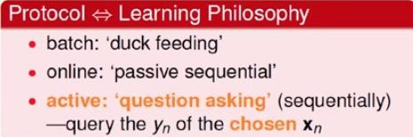
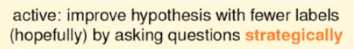
Example : coin recognition
Learning with different data label (有沒有答案可以對)
Supervised => classification : knowing to split to 4 classes (we got answer label)
Unsupervised => clustering : not knowing the answer, only divided by data observations
Semi-supervised => with only a small amount of answer label (e.g. 人臉辨識, 給幾張照片, 要能分辨新的)
Reinforcement => no answer label, but got other hint of good or bad (try -> feedback -> learning -> try…)
Learning with different protocol (與機器溝通互動的方式)
Batch => g is trained ready based on solid data and will not change for testing
Online => g will change and update through data in and out
Active => machine can ask question

Slide 8
Algorithm Hypothesis

Slide 9
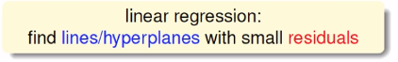
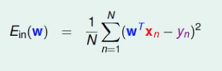
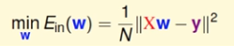
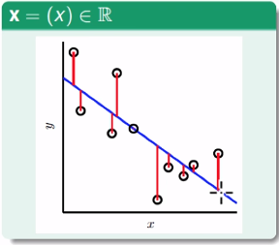
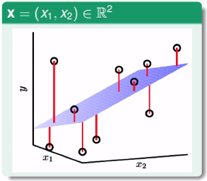
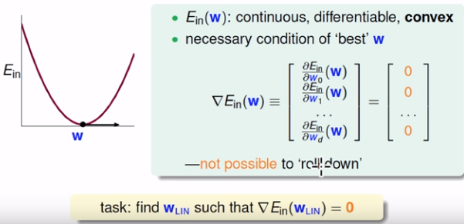
Linear Regression
Deal with Regression yn (Predicit value)
1 dimension : y is a line
2 dimension : y is a plane
Different hypothesis with weight value w(權重) for different attributes x => different prediction for y
Error Measure : square of (predict – true), and the prediction is based on w
From the square error : find the perfect w will have the lowest Ein(w)
數學推導: 當Ein(w) (凸函數) 有最低值得時候, 對所有W梯度都是0 => 算出梯度均維0的時刻, w是多少?

Slide 10
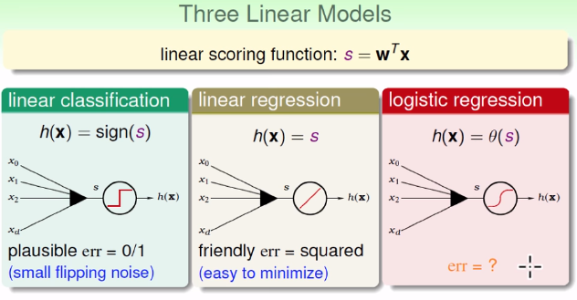
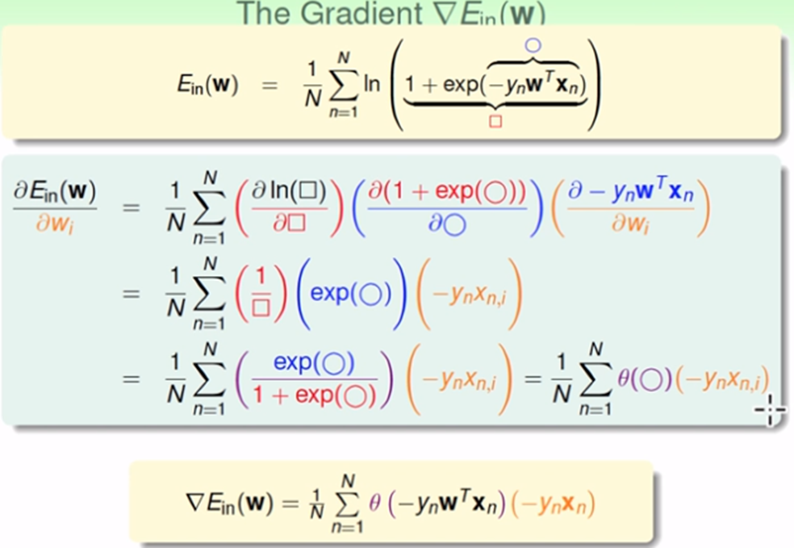
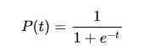
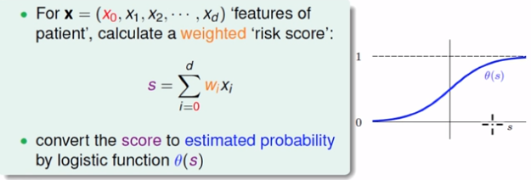
Logistic Regression
Soft binary classification (Binary classification 的延伸)
Binary classification (X = 多筆特徵 x1~xn, Y = 分類 0 或 1, S = WiXi > threshold or not, e.g. 是否給客戶信用卡)
Soft binary classification (X = 多筆特徵 x1~xn, Y = 推測發生0或1的機率, e.g. 預測心肌梗塞的機率)
原本的分數(S =WiXi ) 乘上一個 Logistic function => score convert to 0~1
Error measurement : Ein = ln(1 + exp(-ynxn)
同樣也是convex函數, 用偏微分=0 (梯度=0)時的權重有最小的Ein, 找到最小的w
Logistic function (θ)

Slide 11
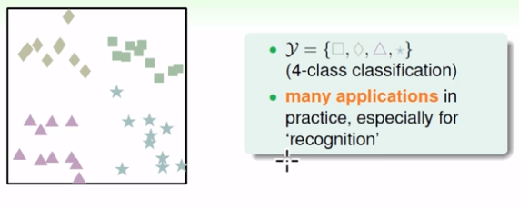
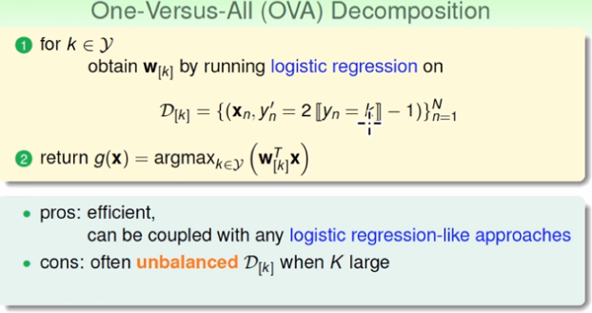
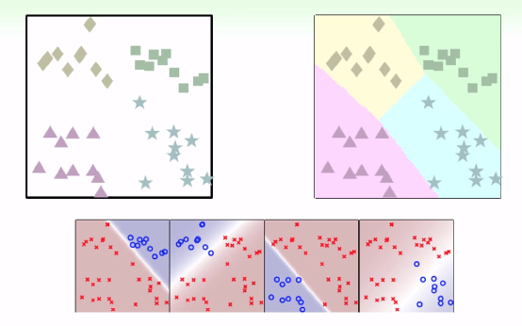
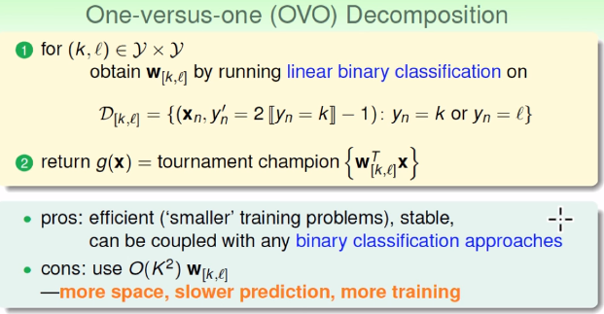
Multiclass Classification (OVA vs OVO)
OVA -> 一打全部
有N類就做N次logistic regression(N個機率分類器)
From binary to multiclass Classification (從是非題到選擇題)
簡單, 有效率
針對每個單一類別先用binary (0/1) 分, 會有模糊地帶
轉成Logistic 去計算模糊地帶的分類機率, 取最大者
類別之間的樣本數不平均會造成機率失真
OVO -> 隨機挑兩種類別做binary, 所有分類器投票
有N類就做”C N 取2”次logistic regression
每個分類器投票, 預測次數太多

Slide 12
Nonlinear separable datasets

Slide 13
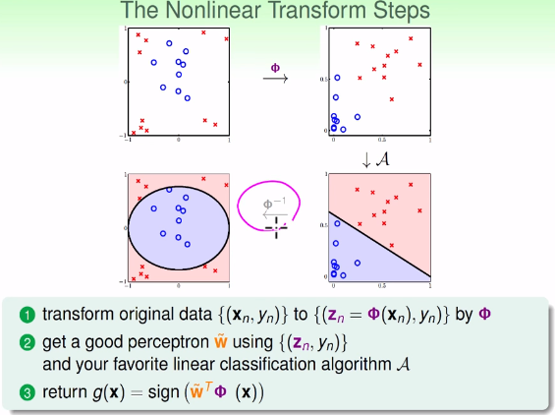
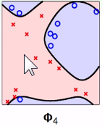
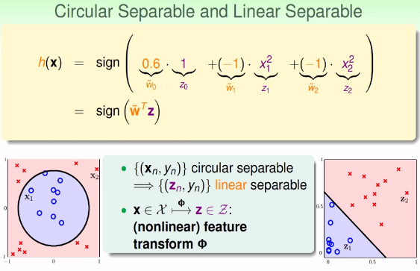
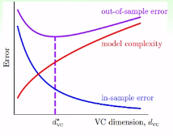
Nonlinear separable case => feature transform
From linear to nonlinear : circle separable ?
h(x) = sign( 1, x1^2, x2^2 , x1x2 …) 分類方法函數變成二次項 ( nonlinear feature transform φ)
X space to Z space ( z0 = 1, z1 = x1^2, z2 = x2^2..) 特徵轉換 => 轉換成二次方項, 在Z空間中即linear separable
Z 空間轉換要考慮X 空間中的全部項次: (1, x1, x2, x1x2, x1^2. x2^2), 才能表示X空間所有非線性可分的情況
(不然就只有圓形/橢圓/雙曲線這種特殊圖形才能描述) (轉換可以轉成很多維, 變成n次曲線用來fit任何狀況…. Good?)
To deal with X space nonlinear separable conditions => find a linear separable hypothesis in Z space
How to find ? 1. Transform datasets Xn : (φ(Xn), Y) 2. 求Z空間解, 反推X空間
轉換代價: 維度變高(^2, ^3…^n) , model complexity 會變高, Ein 可以變得很小, 跟Eout會越差越遠 (背答案:overfitting)

Slide 14
Nonlinear feature transform => overfitting
How to reduce => regularization / validation

Slide 15
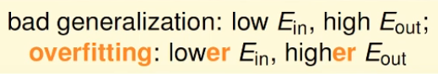
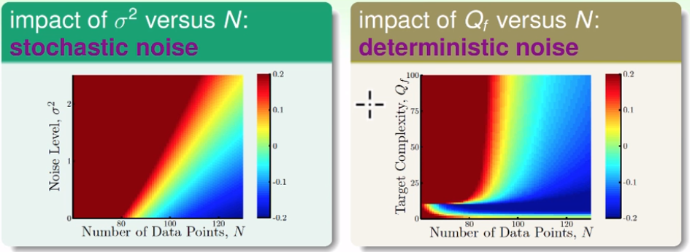
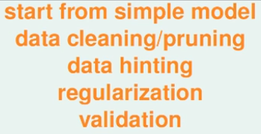
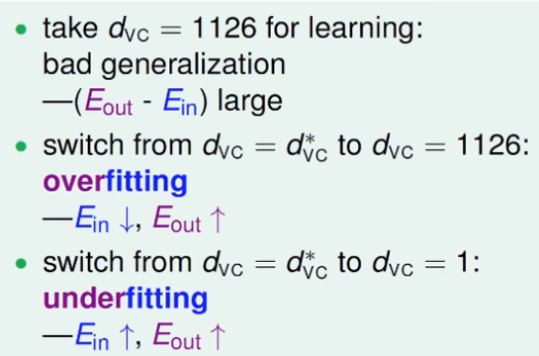
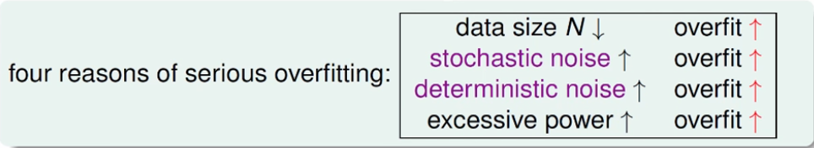
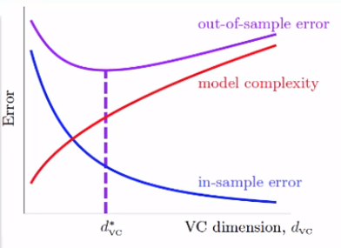
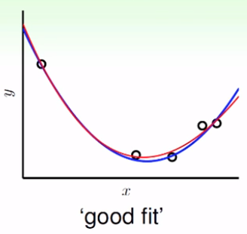
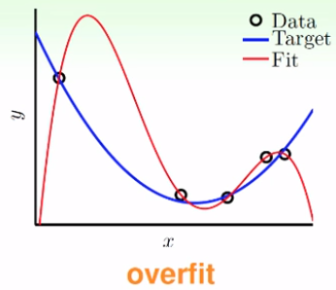
Overfitting
Feature transform => VC dim 過高 => bad generalization (Ein 跟 Eout 差很多) => Ein藉由高次維度精進到很小也沒用
Factors :
Number of data (太小
Noise stochastic (隨機產生)
Noise deterministic (目標函數太複雜產生)
How to avoid
Simple model
(避免VC dimension太大)
Data cleaning/pruning
(修正訓練樣本/刪除 outlier)
Data hinting
(增加更多資料/衍生變書)
Regularization
(權重多寡懲罰項:Ein to Eaug)
Validation
(分成訓練/驗證樣本)

Slide 16
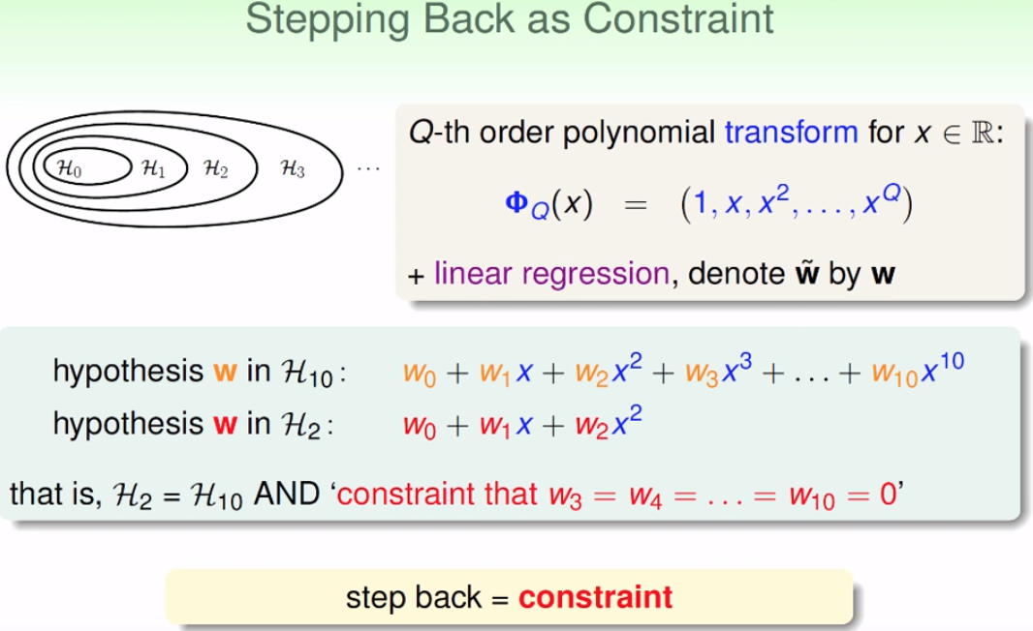
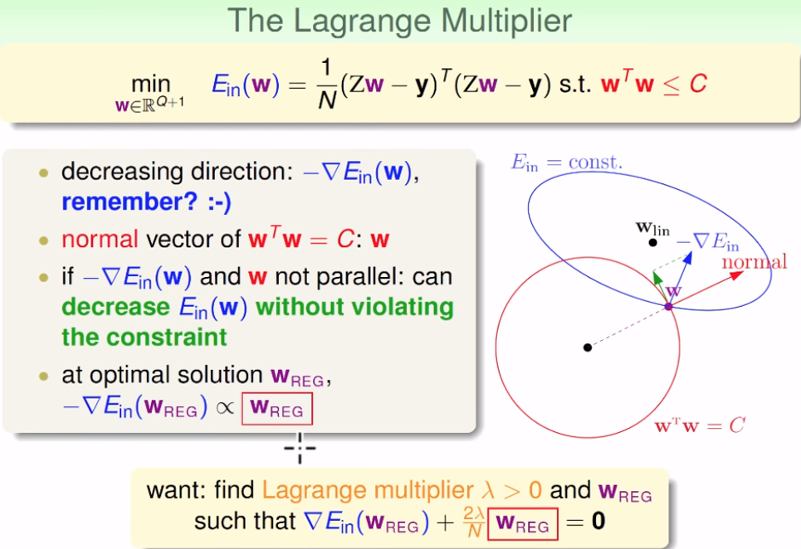
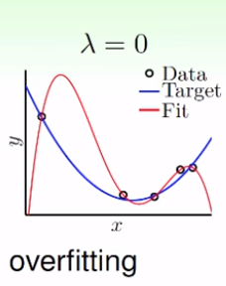






Regularization
To avoid overfitting => 從原本高維度的H走回低維度的H
添加限制條件(w3=w4..w10=0) => 在高維空間裡面找到低維解 (太難解了!)
更改限制條件(w1+w2….wq<=C) => 在高維空間裡面限制多次方項存在的數量
Ein(w) => Eaug(w) , 添加 regularizer (with Lagrange Multiplier)
Linear regression
往負梯度方向走
可以得到Ein最小
但被限制在wTw=C圓上
想要找Ein最小值但要滿足
w1^2+w2^2…wq^2 < 某C值

Slide 17





Validation
Ein is not enough, Etest is unknown => Eval, 切成Dtrain/Dval (用H1…HM驗證) 選最好的
驗證樣本K多大的影響:
太大 => Eval(g-)會跟Eout(g-)很接近, 但是gm- 跟gm 會差很多 (不保證Eout(gm)是小的)
太小 => gm- 之間與gm差不多, 但是Eval跟Eout就會差很遠 (extreme case: K=1, Leave-One-Out)
實際上選用K = D/5, 然後用交叉驗證的方式來將Eval(g-)逼近Eout(g-)=Eout(g) [from LOO to V-fold]
用cross-validation
E的方法逼近
最好的gm-
再做一次到gm
Leave-one-out
只留一個點驗證
多次計算/E跳動大
V-fold
切N份[(N-1) + 1]
計算代價/E比較穩定

Slide 18
More algorithm and hypothesis :
Linear => SVM (large-margin PLA)
Nonlinear => non-hyper plane (CART)
Ensemble => bagging/boosting/stacking
MLP (Nnet) => generate more features
Radial bases function => clustering Kmeans / knn
Matrix factorization => Collaborative Filtering

Slide 19





Support Vector Machine
linear separable case with PLA 有無限多組解(w), 哪個最好? Margin最大的 (noise tolerant 最好)
SVM 附帶的條件就是一種regularization, margin會使解變少並提升
附帶的條件(margin要夠大) 會導致shatter點的能力變差(不能完全分開), 有效的VC dim變小了
Linear SVM
Linear to nonlinear : SVM
目標 : 在滿足完全分開下有最大margin
推導結果 : ½(wTw)要最小
藉由特徵轉換提高VC dimension 但用large-margin限制

Slide 20






Support Vector Machine with kernel
For non-linear case, Dual Support Vector Machine
藉由不同kernel 找到一組W使得增維後的點積=原有維度的點積
kernel種類(Linear/Polynomial, 維度自己調/Gussian, rbf, 無窮多維, 調gamma)
Hard-margin (不允許任何點分錯/邊界要最寬) + 無窮多維核函數 => overfitting (gamma越大越嚴重)

Slide 21



Support Vector Machine with kernel
From hard margin to soft margin => 定義懲罰項
C=懲罰係數, ξ = 與最寬邊界相差的偏離量 (C小, 罰不怕, 很多點都會犯錯)
三種SV: non-SV/free-SV/bounded-SV
Gamma → 變大
C → 變大

Slide 22






Gradient Boosting Decision Tree
Adaboost: 1~T次修正, 每次修正用前一次產生的權重u(t)去做下一次, 最後用α當作比例進行linear blending合成G(x)
Adaboost 最佳化 errADA 包含兩個過程:
決定 u(t) 與 u(t+1) 下次的轉換(summation u1….un 要是最小)
找αn 的比率值
- From Adaboost to Gradientboost => 不只 exp error, 任何error都可以(square/cross-entropy), 同樣都是找出h, η (往哪個方向, 學習步長走多遠)

Slide 23




Ensemble(aggregate) model summary
Blending summary: uniform, linear, conditional
Learning summary: bagging, Adaboost, Gradientboost

Slide 24
Deep Learning

Slide 25



Neural Network
一個Perceptron: sign(x1~xn乘上w1~wn 扣除w0) => 一個g
多個Perceptron(g1~gn)乘上α1~ αn (linear blending) 扣除 bias(g0) => 邏輯運算可得到non-linear的邊界 (powerful)
一層多個Perceptron無法計算XOR問題 => 兩層多個Perceptron (多層多個: MLP) 有能力解複雜問題

Slide 26




MLP hypothesis model (input / transform / output)
Output 可以為任何linear model
分類/回歸/soft class (搭配不同err)\
舉output為範例討論
Transform 激勵函數的選擇
Output linear => 內層用linear沒有意義
不選用離散的階梯函數 => tanh
每一層 [x1,x2…]˙[w1,w2….] input向量與權重向量越相似, s越高(tanh(s)越高)

Slide 27



How to get best w_{ij} with err ---- Backpropagation
舉liner regression output為例, err = square , 用梯度下降求最佳解 (太多層了怎麼做)
Calculus chain rule => 找出前一層δ (err => δ(L) => δ(L-1)….) 可以推回去找到變量
找出最佳解的步驟:
隨便找一組w_{ij}先算
算出各層xi (forward)
用err 推出各層δ (backward)
gradient descent

Slide 28



Deep Learning - why deep?
多層可以產出抽象特徵加以辨識，但是也比較難設計計算訓練
技巧: Regularization (各種避免overfitting的方法)/ initialization（決定一開始第一層的權重很重要）又稱為pre-training

Slide 29




Pre-training
假設一三層NN, 包含了三層權重, 傳統上訓練包含 err 與 各段Xij的計算, 再用backprop回推各層wij權重 (計算繁複)
Pre-training: 分層探討 (先單獨探討wij(1)最佳解, 其他層固定, 再單獨探討下一層), 最後再用training 重新修正各層
權重的意義=> 特徵轉換 (轉成好的特徵), 探討各層最佳解使特徵是好的(確保每一層特徵轉換是有效的)
如何找單層最佳解? Ex: auto-encoder => find identity function (wij & wji) 找到一個特徵轉換使第二次轉換結果回到原本D
Auto-encoder 可做多變化(regularization), denoise autoencoder( input加入雜訊, ouput 原本D) =>再有雜訊情況下還能判定

Slide 30




PCA and linear auto-encoder
Auto-encoder 把激勵函數刪除 => 用wij(1)線性模型當作下一層的input => wji(2) 要算回原本的D (找最佳解?)
Ein(h)找最佳解W=> top eigenvector V (投影到不同的特徵維度, 留下最有效的 => maximize magnitude)
PCA 的概念源自於linear auto-encoder (原本的特徵維度線性變化作特徵轉換, 留下最變化量最大的 => 達到降維的效果）
Ein最小的最佳解w
eigenvaule 最大的eigenvector

Slide 31
Radial Bases Function Network Algorithm

Slide 32



Radial Bases Function Network
Rbf – SVM (kernel function內積相等的特徵轉換=> 找到跟support vector中心點上的距離的線性組合成最大的邊界) Xn/αn
RBF network 同樣也是找出一個最佳解的值再用投票去決定分類或回歸的結果但不同的是:
NNet 適用 wij的權重的成績與激勵函數的結果去決定答案
RBF則是用已知的點找出一個中心 μ, 與其距離差值經由RBF函數作用後線性組合而成的結果來決定(參數: μ, β)
中心μ怎麼決定?線性組合常數β怎麼決定?

Slide 33


RBF network– how to determine μ, β?
Full RBF network => 不知如何決定中心?不如把全部看過的data都當中心(μm = Xm), βm =1 (uniform) => vote
其中一個特例分支 => 預選出只找與未知點距離最小的幾點 => nearest neighbor演算法 (selection instead of vote)
Full RBF network with μm = Xm 若想要以linear model 計算 β最佳解會有overfitting 的疑慮( regularization rbf)
或是不用Xm當中心點(太多中心點了)

Slide 34




K-means and RBF network
如何決定RBF的多個中心μ ? 先做Kmeans 分群分出K個重心的xn
K-means 用相差距離的總和決定群(S1..Sn), 用群與群間平均的重心決定(μ1… μn)
有了群之後再套用RBF, 用linear model找出可以使square err 最小的 β
用非監督式學習的演算法預先找出重心(預先做特徵轉化), 再做監督式學習的分類

